Slide 1
Sustainable cities and how to preserve them
Introducing a team of Sirius

Slide 2
1\Sustainable urban planning
Cities around the world face increasing challenges in urban development,including environmental pollution, greenhouse gas emissions,natural resource depletion,and population growth. To overcome these challenges,sustainable cities and sustainable urban planning are vital solutions.
Sustainable cities
are those that strive to achieve a balance between the current needs of the population and those of future generations. This is done through the development of strategies and policies aimed at preserving natural resources and improving quality of life.
Sustainable urban planning involves
designing and developing cities in a way that promotes environmental, economic, and social sustainability. This includes the use of modern technology and innovations in infrastructure design, promoting public transportation and clean mobility, developing green spaces, and providing easy access to them.

Slide 3
The importance of sustainable cities and sustainable urban planning
1.Environmental Protection: Sustainable urban planning contributes to preserving the natural environment, reducing pollution, and preventing resource depletion.
2.Economic Growth: Sustainable urban planning promotes sustainable economic growth and provides job opportunities.
3.Improved Quality of Life: Sustainable urban planning aims to provide a healthy and comfortable urban environment for residents, leading to an improvement in quality of life.

Slide 4
Achieving sustainable cities and sustainable urban planning:
Resources | Germany | Singapore
Sustainable energy | Sept 2010 | Nov 2018
Waste disposal | Jan 2016 | Oct 2020
New technology | Mar 2022 | May 2023
1.Developing effective government policies that promote sustainability in urban planning and development.
2.Encouraging innovation and investment in smart and sustainable infrastructure.
3.Promoting awareness and education among the population about the importance of sustainable practices in daily life.

Slide 5
2\ Green hydrogen is a clean and renewable source of energy, making it a kay element in achieving sustainability in cities.
Project Objectives:
● Raising awareness of the importance of green hydrogen:
○ Clarify the benefits of using green hydrogen in cities.
○ Highlight the contribution of green hydrogen to achieving sustainability.
● Providing realistic solutions
○ Present available green hydrogen technologies.
○ Offer successful case studies of green hydrogen applications in cities.
● Encouraging participation:
○ Encourage individuals and institutions to use green hydrogen.
○ Support policies and legislation that promote the use of green hydrogen
Initiation
Implementation
Planning
Monitoring
Follow-up

Slide 6
. Content:
1. What is Green Hydrogen?
2. Benefits of Using Green Hydrogen in Cities:
● Reducing Carbon Emissions:
○ Reducing air pollution and improving public health.
○ Contributing to combating climate change.
● Reducing Reliance on Fossil Fuels:
○ Promoting energy security.
○ Reducing energy costs.
● Creating Job Opportunities:
○ Stimulating the growth of the green sector.
○ Supporting economic development.

Slide 7
3. Available Green Hydrogen Technologies:
● Photovoltaic Solar Energy Systems:
○ Converting sunlight into electricity.
○ Used to power homes, buildings, and businesses.
● Solar Thermal Energy Systems:
○ Converting sunlight into thermal energy.
○ Used to heat water and provide heating and cooling.
4. Successful Case Studies of Green Hydrogen Applications in Cities
: ● Copenhagen, Denmark: ○ Known as the "City of the Sun".
○ Meets 50% of its energy needs from solar energy.
● Masdar City, UAE:
○ A sustainable city that relies entirely on renewable energy.
○ A leading model for sustainable cities.

Slide 8

5. How Can We Promote the Use of Green Hydrogen in Cities? ● Supporting Policies and Legislation: ○ Enacting incentive laws for the use of green hydrogen. ○ Providing financial incentives for investors in green hydrogen projects. ● Raising Awareness: ○ Organizing awareness campaigns about the benefits of green hydrogen. ○ Educating the community about available green hydrogen technologies. ● Investing in Research and Development: ○ Supporting the development of new technologies for green hydrogen. ○ Reducing the cost of green hydrogen systems.
Conclusion: Green hydrogen is a key element in achieving sustainability in cities

Slide 9
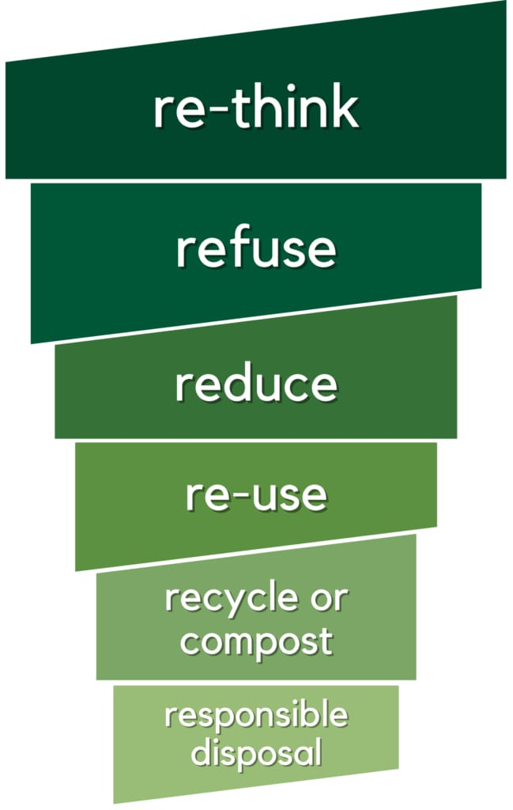
3\Waste management in sustainable cities Subtitle:Building a greener future
Introduction:
Challenges in Waste Management
-Discussion of the challenges faced in waste management, including increasing urbanization, population growth, and resource depletion.
-Impact of improper waste management on public health, environment, and economy.
● Principles of Sustainable Waste Management
-Introduction to the principles of sustainable waste management:
-Reduce
-Reuse
-Recycle
-Recover
-Dispose

Slide 10
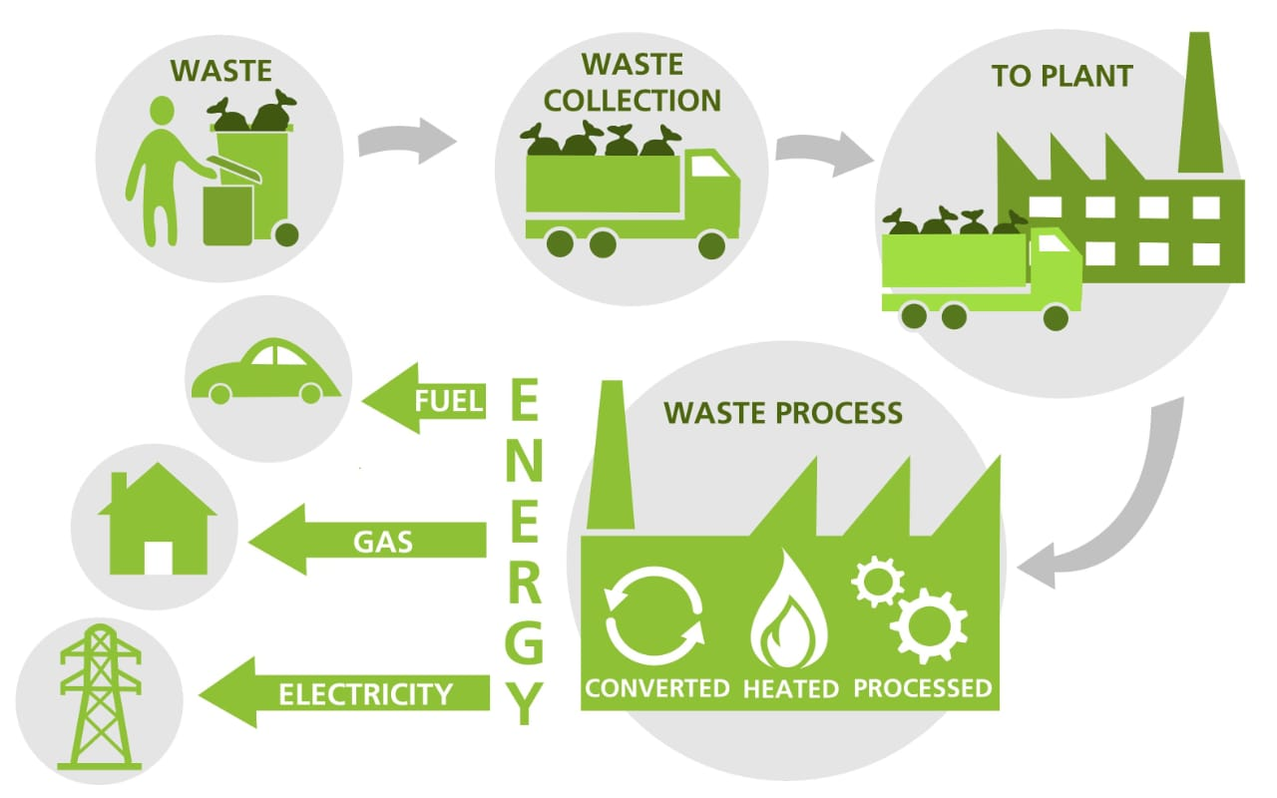
● Strategies for Sustainable Waste Management
-Overview of strategies for sustainable waste management:
- Source reduction
-Waste segregation and recycling programs
-Composting
-Waste-to-energy technologies
-Extended Producer Responsibility (EPR)
●Case Study: Waste Management Initiatives in [Sweden]
-Description of successful waste management initiatives implemented in a specific city.
-Highlighting key strategies, challenges faced, and outcomes achieved.

Slide 11
● Benefits of Sustainable Waste Management
-Discussion of the benefits of sustainable waste management, including:
-Reduction of greenhouse gas emissions
-Conservation of natural resources
-Creation of green jobs
-Improvement of public health
-Enhancement of urban aesthetics
● Technological Innovations in Waste Management
-Overview of technological innovations contributing to sustainable waste management:
-Smart waste collection systems
-Waste sorting robots
-Sensor-based monitoring systems
-Waste-to-energy technologies
●Community Engagement and Education
-Importance of community engagement and education in promoting sustainable waste management practices.
-Examples of community-based initiatives and educational programs.

Slide 12
●Policy and Regulation
-Discussion of the role of policies and regulations in promoting sustainable waste management.
-Examples of effective waste management policies and regulations at local, national, and international levels.
Conclusion:
By implementing effective waste management strategies, cities can mitigate environmental pollution, conserve resources, promote public health, and create economic opportunities.

Slide 13

4\ Technological innovation
1.Artificial intelligence technology in traffic management: Using artificial intelligence systems to improve traffic flow, reduce congestion, and improve the efficiency of road use.
2. Internet of Things (IoT) for energy management: Integration of smart sensors and IoT systems to monitor and optimize energy consumption in buildings and public facilities.
3. Green infrastructure technology: Developing infrastructure systems that use sustainable materials and rely on green construction techniques to reduce environmental impact.
4. Renewable energy technologies in construction: Integrating renewable energy generation systems such as solar panels and wind energy into the design of buildings to achieve sustainability in energy supply.

Slide 14
5. Improving resource recycling through technology: Using advanced technologies to increase the effectiveness of recycling processes and the correct disposal of waste.
6. Cloud computing technology to improve resource management: Using cloud computing to improve the efficiency of resource use and reduce energy consumption in data centers and government systems.
7. Smartphone applications for urban life: Develop interactive smartphone applications to improve citizens’ experience in sustainable cities, such as sharing information about public transportation and solar parking.
8. Urban efficiency management systems: Data analysis technology to improve city planning and better identify infrastructure needs based on population behavior and urban developments.
9. Robotic technology for urban maintenance: Using robots to carry out maintenance and cleaning work in streets and public areas, which reduces the use of human resources and improves public hygiene.
10. Environmental monitoring techniques: Using advanced systems to monitor air, water and noise quality to maintain a healthy environment in cities.

Slide 15
Presentation team
E-mail | phone number | Name
 | +201016701329 | T.L \ Mohamed Ali Kassab
modyomar576@gmail | +201101552079 | M \ Mohamed Omar Ahmed
me2750105@gmail.com | +201273931469 | M \ Maryam Elsayed Mohamed
 | +201064940778 | M \ Maryam Ehab

